Slide 1
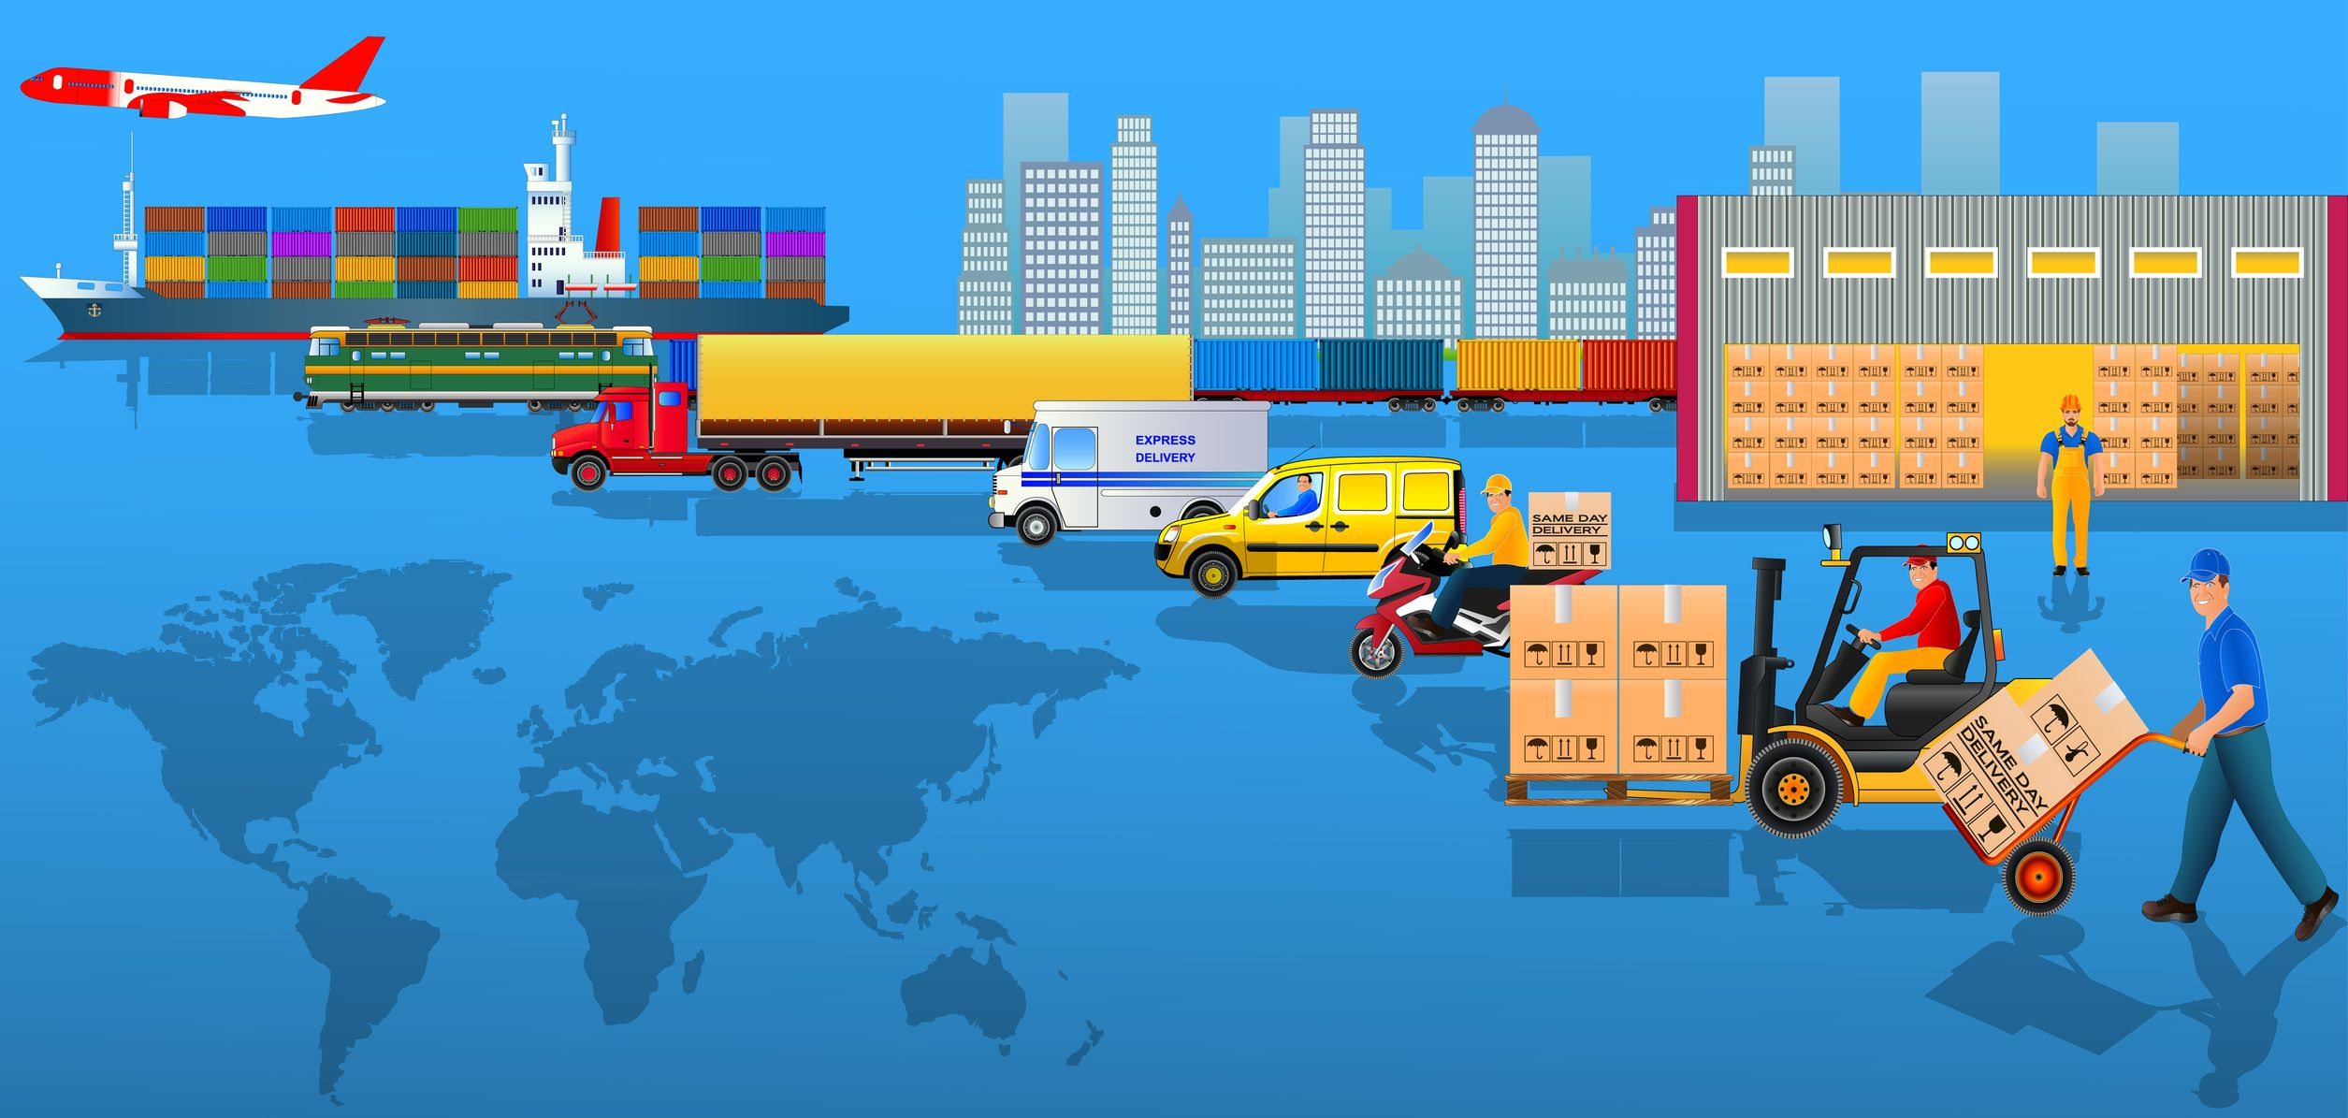
Major issues and challenges affecting logistics business.
Challenges Affecting logistics business

Slide 2
The logistics industry plays a critical role in any economy as it enables the movement of goods and products from one place to another. Industries like Agriculture and manufacturing are highly dependent on logistics making it a crucial driver of trade and the economy at large. However, the logistics business faces numerous issues and challenges that derail its smooth operations.
The following are challenges affecting the industry.
  Fuel costs.
  Transportation consumes a larger portion of logistics expenditure and this is informed by the cost of fuel. An increase in fuel costs translates to more charges on clients affecting their purchasing power and increased shipping costs will affect the company’s revenue. The rising fuel costs will also cut into industry players’ earnings like the truckers.

Slide 3
  Improving Customer Service.
The logistics market is competitive, therefore improving customer service is crucial for the company to retain its customers and attract more. Customers have high expectations of product delivery timelines and quality of service. This poses a challenge to the company to ensure a seamless flow of operations with its clients.
  Improving business procedures.
Logistics businesses should strive to improve business procedures and look out for advancements and adapt accordingly. Keeping up with new advancements in business improves their service delivery and efficiency in their operations. Improving business procedures also helps in cutting down on operation costs. Despite the costs and risks associated with this venture, the company should take up this challenge for long-term benefits.

Slide 4
  Reverse logistics.
Implementing a reverse logistic plan in the logistics company remains a big challenge as it is risky and costly. A return policy should be developed to allow customers to return purchased products they are unsatisfied with. The policy should be effective to ensure that the company does not alienate its customers and eventually lose them.
  Government regulations.
There are laws and regulations set by states and governments for the logistics industry and logistics companies have an obligation to adhere to them. These regulations and measures differ by region. This can be an additional burden for the company to educate its staff about these restrictions and the company may also face heavy penalization if they fail to comply.

Slide 5
  Environmental regulations.
The logistics and transport infrastructure has brought environmental issues, for instance, the increase in carbon emission, which affects the environment negatively. There are regulations aimed at reducing these emissions which are costly to the logistics companies. Logistics companies are under pressure to adopt other sustainable energy sources to protect the environment. It is a challenge for companies to adopt these clean sources since they require a significant amount of resources.
  Shortage of drivers
Shortage of drivers is still a major challenge for most logistical companies, as hiring and retention remain to be an issue. Drivers are a necessity in the logistics industry for product delivery. Logistics companies should offer amenities that are of interest to drivers and develop positive relationships with them to retain and attract drivers.
  Lack of skilled labor.
Many logistic companies lack skilled and competent manpower. With the advancement in technology and change in business operations, logistics companies need to have specialized experts for effectiveness and efficiency. However, many companies lack skilled personnel and as a result, these businesses struggle to operate smoothly.

Slide 6
  Technology integration.
Technology is crucial in the realization of success in the industry however, most businesses have problems in implementing technological advancements due to the expensive costs and lack of capacity. The high cost is only favorable to large and established logistic companies since making competition stiffer for smaller companies.
Conclusion
Logistics businesses should adapt to these challenges in order to stay competitive in the market by embracing technology, skills development, partnerships and collaborations, and infrastructural development.

Slide 7
References
DDC FPO (2017, November 1)
Challenges facing the logistics industry: Logistics Management.
source. https://www.logisticsmgmt.com/article/top_8_logistics_challenges_facing_the_industry
Bhavya Singh, Stockarea (n.d.)
Biggest Challenges Faced By Logistics Companies: Logistics Brew.
source.
https://stockarea.io/blogs/10-crucial-challenges-faced-by-logistics-companies/

