Slide 1
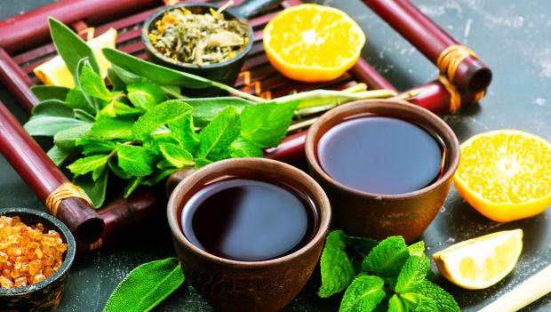
HERBAL MEDICINES

Slide 2
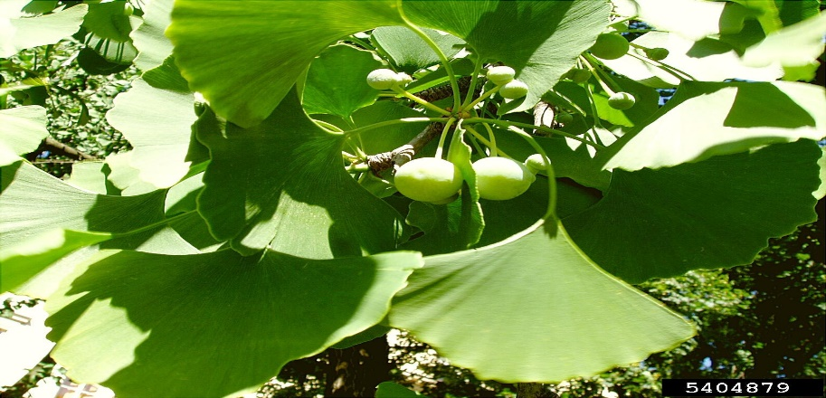
GINKGO BILOBA
Name of medicine-Salisburia
It contains potent antidoxidants.
Can be bought at supermarkets as a fruit or if dried to make tea.
Reasons for use
It treats:
Heart diseases
Dementia
Mental difficulties
Sexual dysfuction

Slide 3
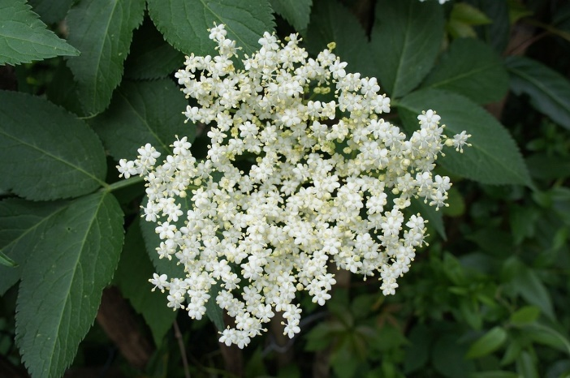
ELDERBERRY
Name of medicine-Sambucol
It contains antioxidant and antimicrobial.
Reason for use
Relieves:
Headaches
Nerve pain
Toothaches
Colds
Viral infections
Constipation

Slide 4
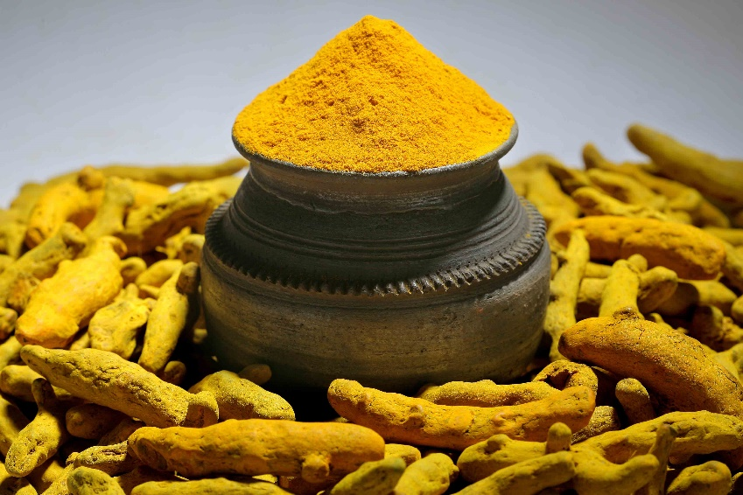
Tumeric
Name of medicine -Curcurmin suppliments
Contains Curcumin.
Reasons for use
Lowers Cholesterol (detox)
Treats skin conditions
Treats Alzheimer’s disease

Slide 5
Reasons why people use these medicines
People use Herbal medicine as Detoxification materials ,skin care materials and to help in curing many types of diseases. All types of diseases have their main reasons for the use of the herbs .

Slide 6
My thoughts on Herbal medicine
> Herbal medicinces should be kept in consideration in the big market. They should be used more often.

Slide 7
Do you believe that herbal medicine work?
Yes , I do believe that Herbal medicine do work .

Slide 8
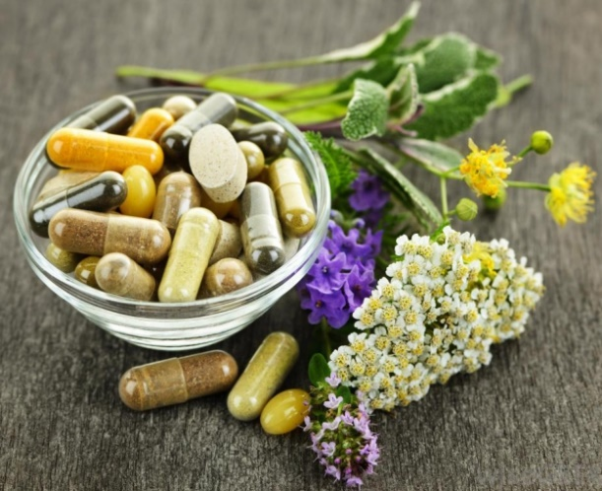
Conclusion
Herbal medicine is one of the best raw materials to be used in the manufacture of medicine. Herbal medicine is the best for both traditional and modern methods of healing and prevention of different diseases.

