Slide 1
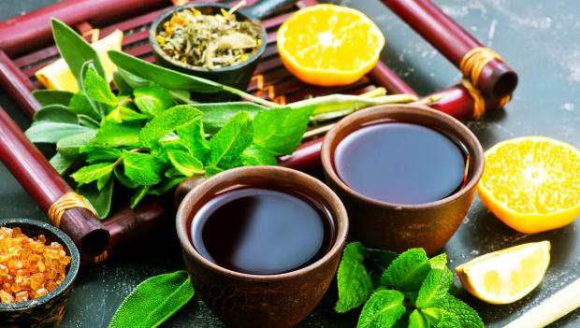
HERBAL MEDICINES

Slide 2
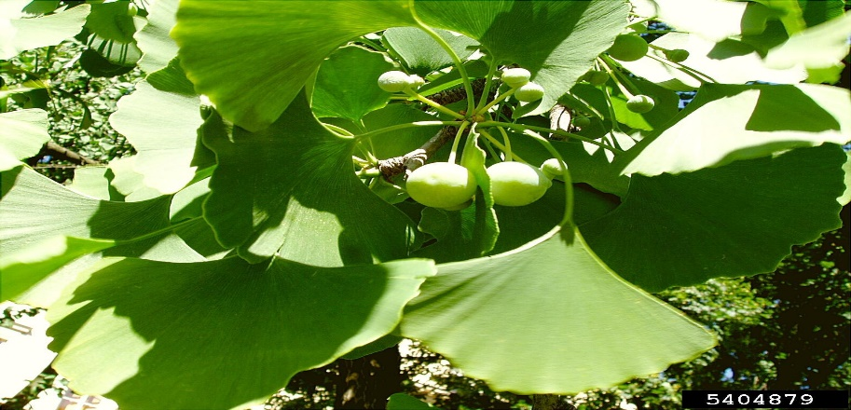
GINKGO BILOBA
Name of medicine-Salisburia
•It contains potent anti-oxidants.
•Can be bought at supermarkets as a fruit or if dried to make tea.
Reasons for use
It treats:
•Heart diseases
•Dementia
•Mental difficulties
•Sexual dysfunction

Slide 3
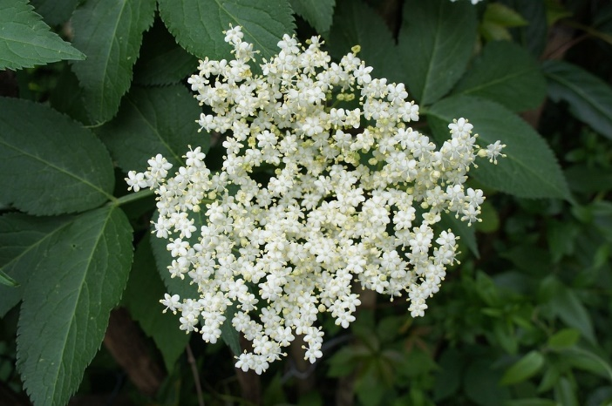
ELDERBERRY
•Name of medicine-Sambucol
•It contains antioxidants and antimicrobials.
Reason for use
Relieves:
• Headaches
• Nerve pain
• Toothaches
• Colds
• Viral infections
• Constipation

Slide 4
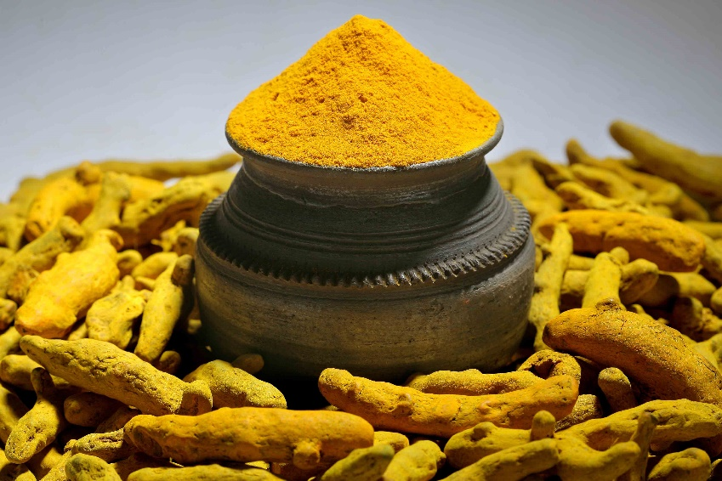
Tumeric
Name of medicine -Curcurmin supplements
Contains Curcumin.
Reasons for use
Lowers Cholesterol (detox)
Treats skin conditions
Treats Alzheimer’s disease

Slide 5
Reasons why people use these medicines
People use Herbal medicine as Detoxification materials and skin care materials to help cure many types of diseases. All types of diseases have their main reasons for the use of herbs.

Slide 6
My thoughts on Herbal medicine
Herbal medicine should be kept in consideration in the big market. They should be used more often.

Slide 7
Do you believe that herbal medicine work?
Yes, I do believe that Herbal medicine does work.

Slide 8
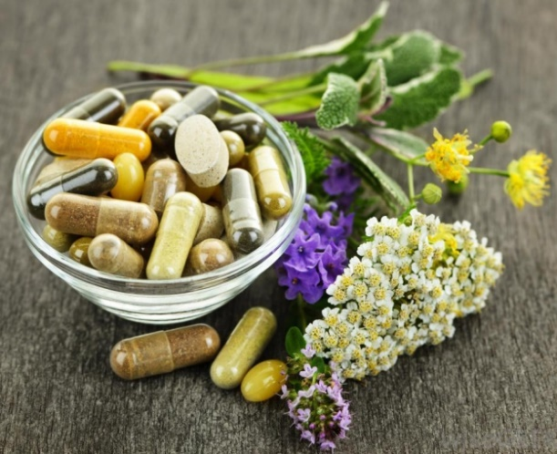
Conclusion
Herbal medicine is one of the best raw materials to be used in the manufacture of medicine. Herbal medicine is the best for both traditional and modern methods of healing and prevention of different diseases.

